Slide 1


FRT & CERT APP
First Response & CERT management tool
Supervisor - Dr. Unkelos-Shpigel Naomi
Yuval Badihi & Sharon Mor

Slide 2
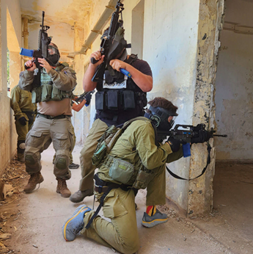

Emergency Response Units
First Response Team (FRT): Armed residents organized into small units for rapid emergency response through patrolling and gatekeeping.
Community Emergency Response Teams (CERT): Trained community volunteers enhancing resilience by managing injuries, hosting educational events, and coordinating logistics during crises.

Slide 3
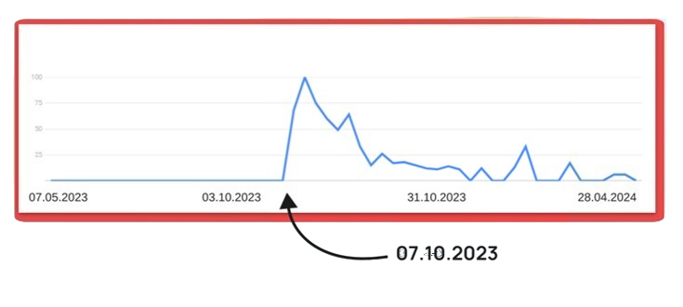

Need for Rapid First Response
In emergencies, the army and other traditional systems like police and fire services often face delays, which can be critical.
Rapid first response is essential in cases such as:
Increase of Terror Attacks
Natural Disasters
Incidents within the community
‘כיתת כוננות’ on google trends

Slide 4






The Problem
First response teams lack adequate management tools.
Consequences: Leads to communication breakdowns, delays, and inefficiencies.
Devastating Outcomes: These issues can have devastating consequences during emergencies.

Slide 5

Existing FRT Management Tools
 | GPS Tracking | Smart Map | Chat | Wellness Check | Groups | Task Assignment
Avuka | ✔ | ✔ | ✔ |  | ✔
AVIA | ✔ | ✔ | ✔ | ✔ | ✔
Zello |  |  | ✔ |  | ✔
WhatsApp* |  |  | ✔ |  | ✔
Our Solution | ✔ | ✔ | ✔ | ✔ | ✔ | ✔

Slide 6



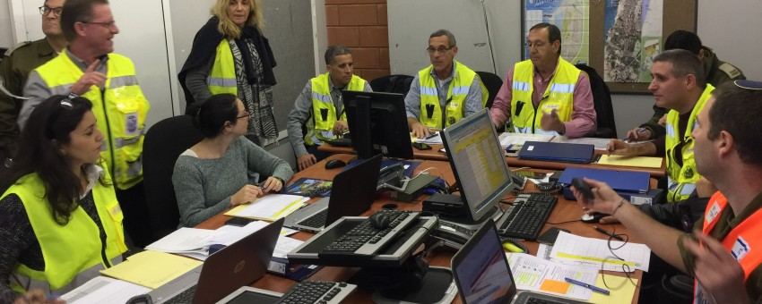

Our Solution
Advanced Web and Mobile Solution for First Response Teams
Website
Mobile
Notes:
Advanced Web and Mobile Application for Emergency Response Teams
Optimized Communication: Tailored to enhance coordination among first and community emergency response teams, especially in high-risk and recently impacted areas.
Operational Efficiency: Streamlines processes to improve response times and effectiveness, with a complex web application for deep logic operations and a simpler, intuitive mobile app for on-the-go accessibility.
Exceptional User Interface and Accessibility: Committed to delivering a user-friendly experience that is accessible and inclusive for all users, ensuring efficient operation across devices.
Comprehensive Feature Set:
Task Management: Enables assigning, tracking, and updating tasks efficiently.
Interactive Map: Provides real-time geographical data for strategic planning and response.
Roles and Permissions: Ensures information security by assigning specific capabilities and access based on user roles.
Adaptable Views: Allows entities like Regional Councils to monitor activities across different settlements.
Message Board: Facilitates effective communication and information sharing among team members.
Reports Page: Archives and allows easy retrieval of past reports for review and analysis.
Alarm and Event Systems: Enhances response capabilities with customizable alerts and a structured event management framework.

Slide 7
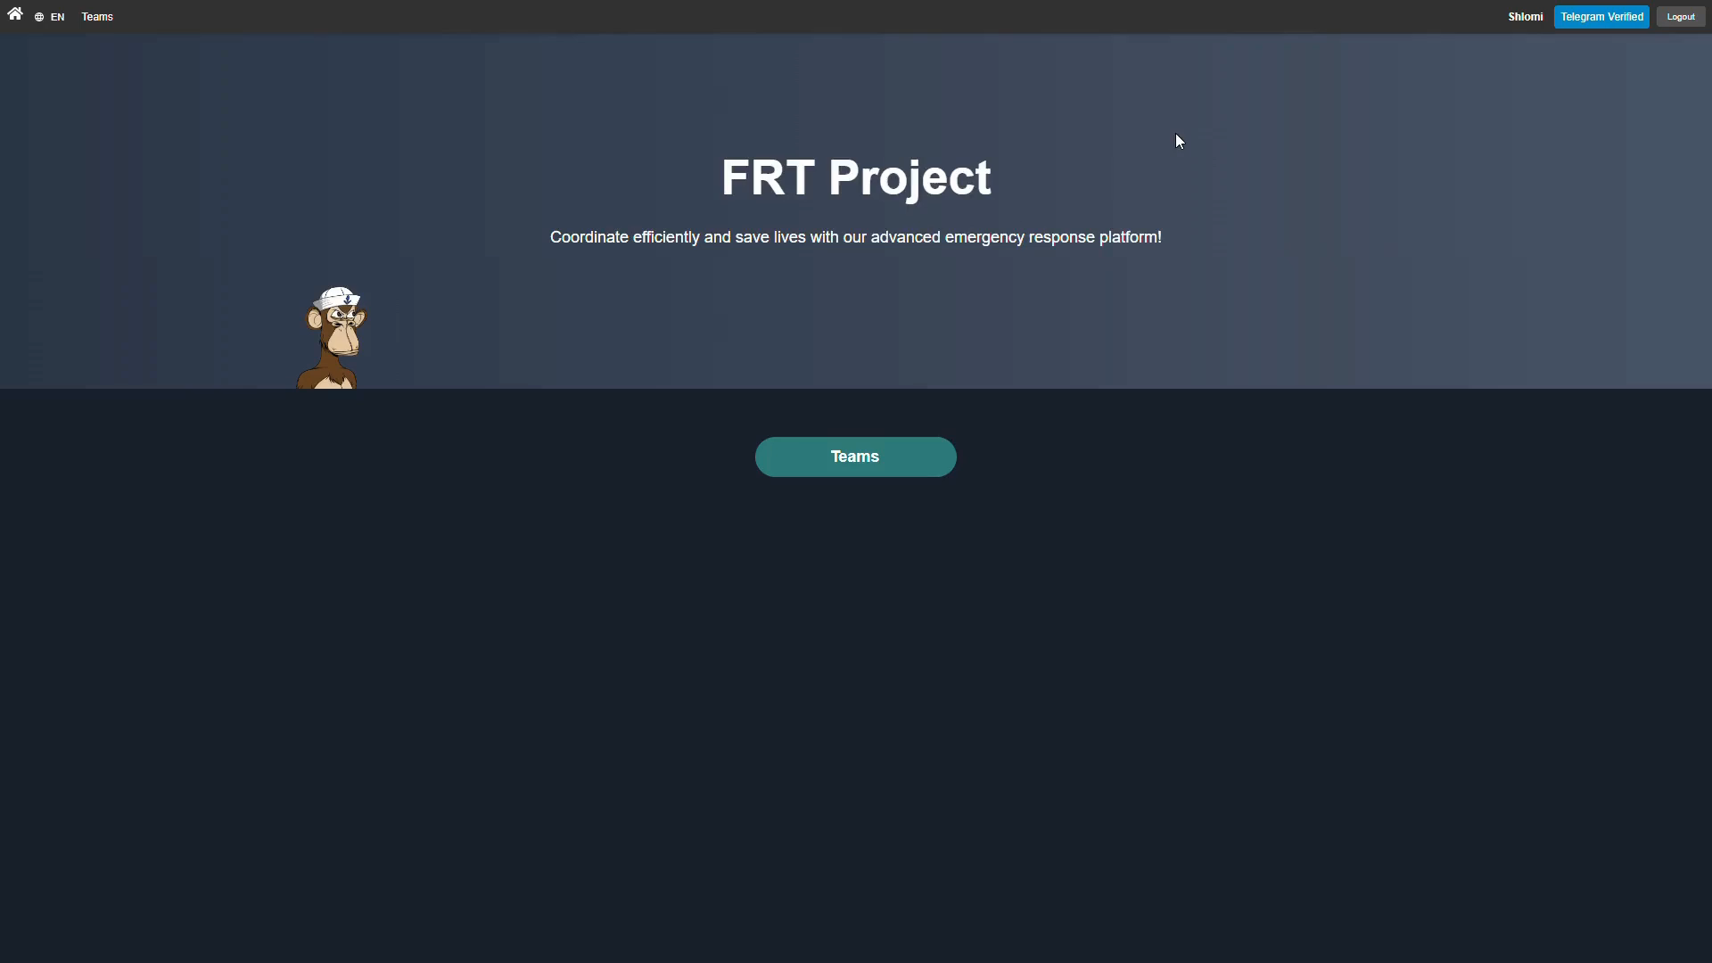

Slide 8





Our App in a Nutshell
Task Management
Cross Platform
Health Check
Messaging System
Interactive Map
Activity Log

Slide 9




Requirements
User Management
Communication
User authentication
Role-based access control
Team creation and management
Member invitation and removal
Real-time chat messaging
Image sharing
Telegram bot integration
Cross-platform synchronization
Mission Management
Mapping & Location
Create missions
Track mission status
Multiple mission types
Interactive map interface
POI management
Custom markers
Location sharing

Slide 10
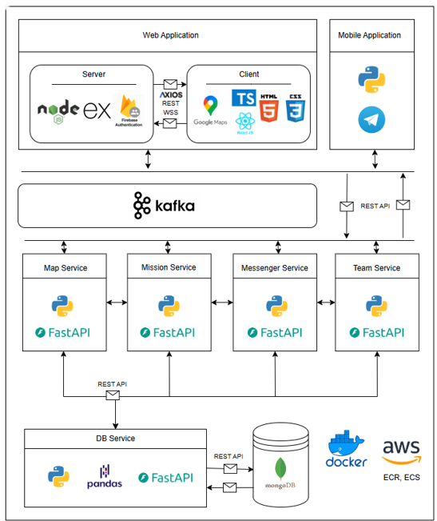
Architecture

Slide 11


Tech Stack
Web & Mobile
Backend Services
React – UI Library
Express JS – BFF Server
Node JS – JS Runtime
Google Maps API
Telegram bot
Mapping Service
Chat Service
Teams Service
Missions Service
DB Service
Deployment & Containerization
Streaming
AWS – ECR, ECS, Route 53
Docker – containerization
Kafka

Slide 12
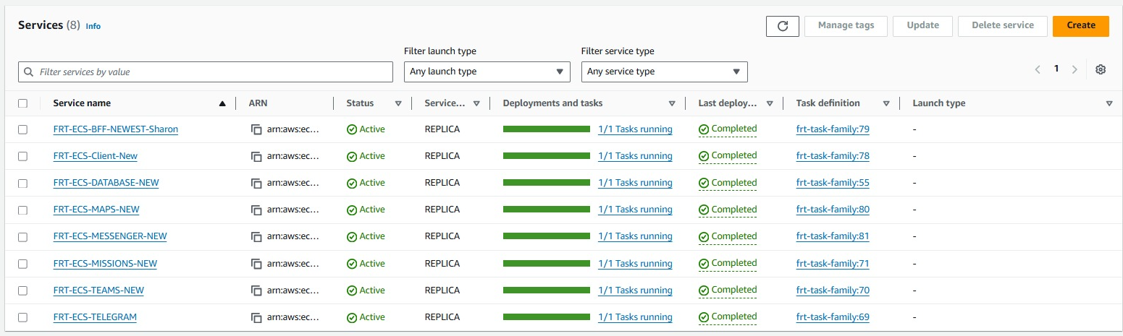
System Services

Slide 13


System Evaluation
Expert Interview
Amir Dagan Head of health community emergency response team, Kibbutz Megiddo
An in-depth system interview and walkthrough was conducted at Kibbutz Megiddo on November 7, 2024.
SUS Survey
Survey conducted with 20 potential system users
Notes:
BI Events - Key activities within our system where data is collected and analyzed to improve decision-making
SUS (System Usability Scale) - A tool to evaluate the usability of our product through standardized questionnaires.
CSAT (Customer Satisfaction Score) - A metric assessing customer satisfaction with our product or service through quick surveys

Slide 14

System Walkthrough
Interview Findings - Mr. Amir Dagan, Head of health CERT, Kibbutz Megiddo
Key Observations
Suggested Improvements
Tested All system’s features
Positive assessment of core functionalities
Real-World validations
Voice command Processing:
AI-powered voice processing
Automatic voice-to-action conversion

Slide 15
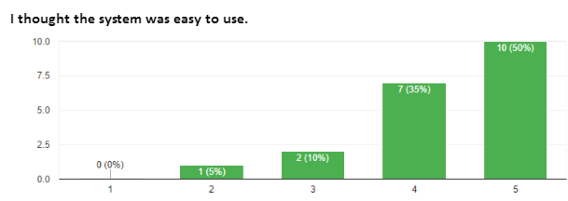
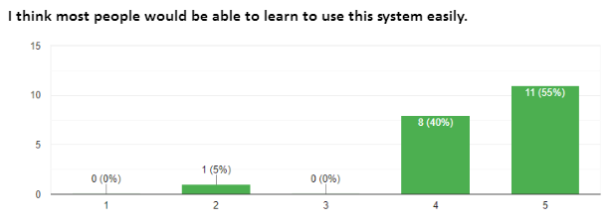
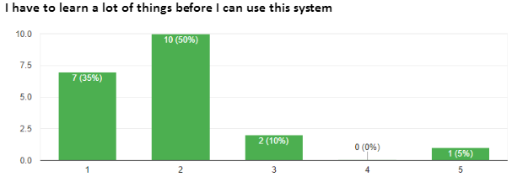
SUS Survey
Survery Overview
20 Participants
Overall, SUS Score: 83.375
"Excellent!“
"The system offers a very user-friendly and convenient interface. The ability to control events on the field map is excellent for maintaining local situational awareness.“
"A critical limitation is that when external forces are involved, the system doesn't support their integration, which results in reduced control capabilities."

Slide 16

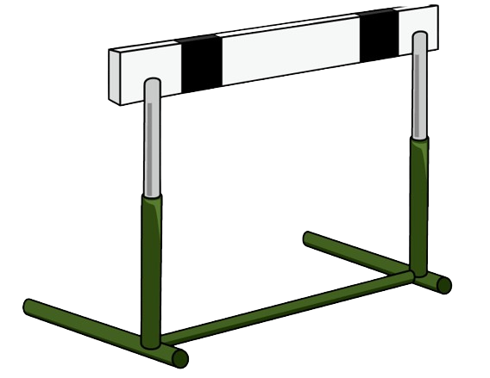
Overcoming Challenges
Challenge | Solution
Mobile Development | Implemented Telegram bot interface instead of native mobile app development
Deploying Multiple Services | Docker Compose for orchestration, AWS ECS for service management, separate task definitions with proper configurations
Parallel Development | Git for version control while focusing on separate domains
Notes:
Data Synchronization: Ensuring seamless sync across devices in fluctuating network conditions.
Interface Simplicity vs. Feature Richness: Balancing a simple user interface with the complex functionalities needed by different teams.
Scalability: Preparing the system to handle increasing amounts of data and users without performance loss.
Tech: React Native - new to us, Deployment to both IOS and Android

Slide 17
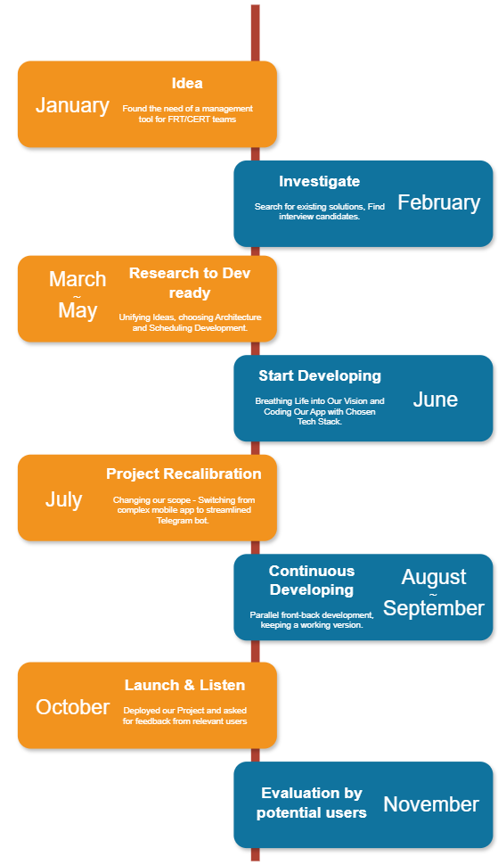
Engineering Process

Slide 18



Our Personal Journey
Meaningful project with potential for real-world impact
Demonstrated clear necessity in emergency response field
We have learned a lot!
Multi-platform Architecture
AWS & Docker Deployment
Real-time Systems (Kafka & WebSockets)

Slide 19



Thank You Questions

